Slide 1
Artificial Intelligence Course
Introduction to machine learning
Lec 1
Credits: This material is based mainly on Andrew NG’s Coursera ML course

Slide 2

Peter Flach, Machine Learning. The Art and Science of Algorithms that Make Sense of Data.
T. Mitchell, Machine Learning,
McGraw-Hill
John D. Kelleher, Fundamental of Machine Learning for predictive Data Analytic.

Slide 3


Traditional Programming
Data Program
Output
Machine Learning
Data
Output
Program

Slide 4
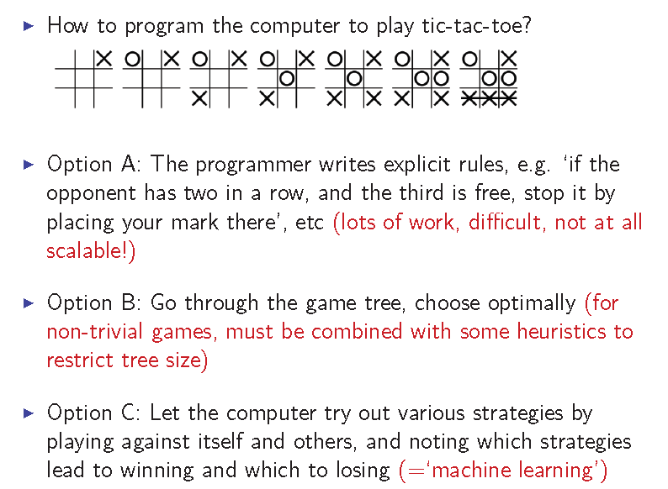
Examples
Example 1 : Tic-Tac-Toe

Slide 5
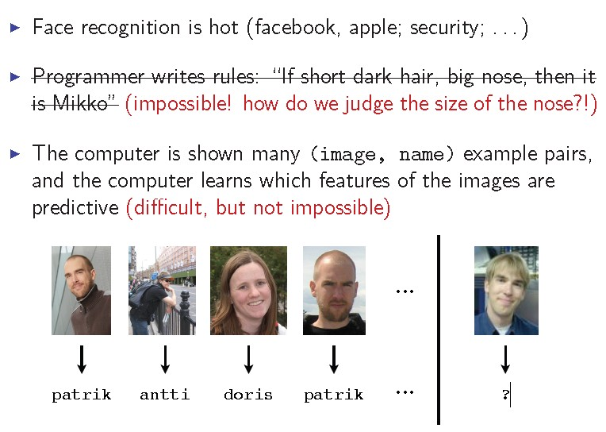
Examples
Example 2 : face recognition

Slide 6
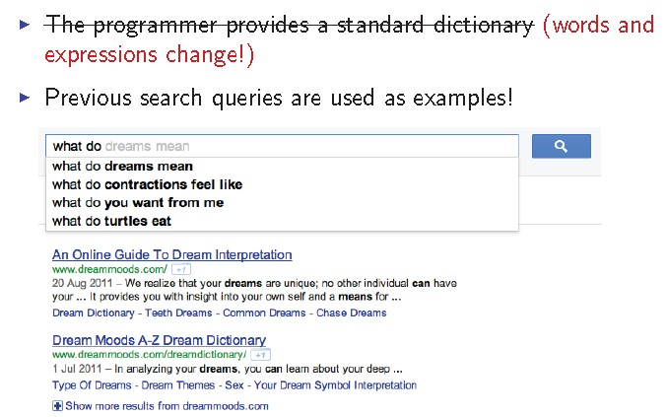
Examples
Example 3: Prediction of search queries

Slide 7
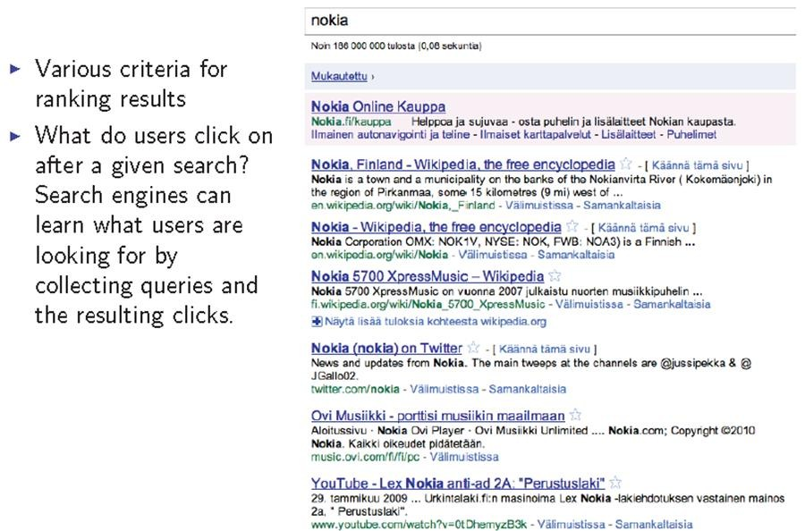
Examples
Example 4: Ranking search results

Slide 8
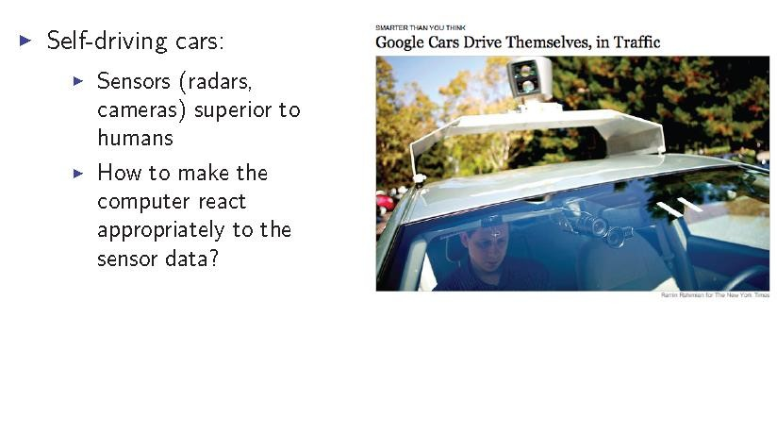
Examples
Example 5

Slide 9
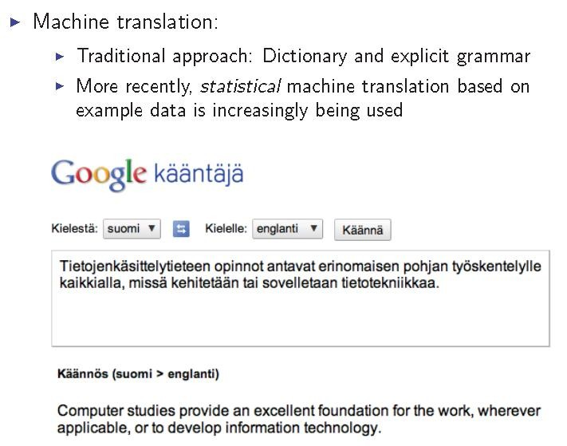
Examples
Example 6

Slide 10
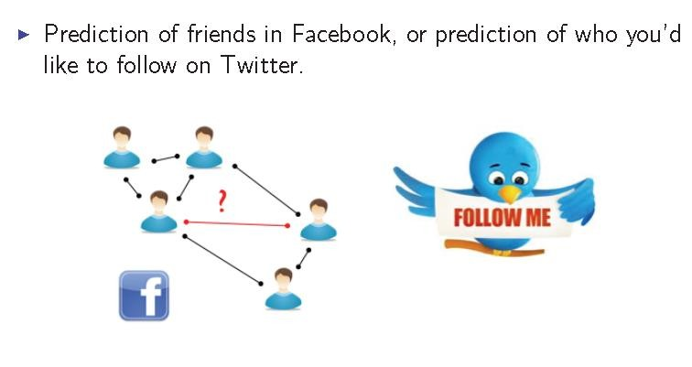
Examples
Example 7

Slide 11
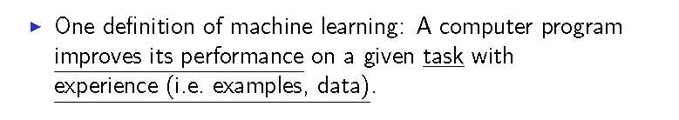
Problem setup
So we need to separate
Task
Experience
Performance

Slide 12

1- task
Machine learning allows us to tackle tasks that are too difficult to solve with fixed programs written and designed by human beings.
Machine learning is interesting because developing our understanding of machine learning entails developing our understanding of the principles that underlie intelligence.

Slide 13
1- task (Cont.)
Some of the most common machine learning tasks include the following:
Classification : In his type of task, the computer program is asked to specify which of k categories some input belongs to.
-Classification Algorithms attempt to map inputs into one of a set of classes (Colors, Good and Bad Credit Risks)
Regression : In this type of task, the computer program is asked to predict a numerical value given some input.
-Regression Algorithms attempt to mapinputs into continuous output (Integers,Real Numbers, Vectors, etc.)

Slide 14
1- task (Cont.)
Some of the most common machine learning tasks include the following:
3- Transcription: In this type of task, the machine learning system is asked to observe a relatively unstructured representation of some kind of data and transcribe it into discrete, textual form.
E.g.: optical character recognition (OCR), where the computer program is shown a photograph containing an image of text and is asked to return this text in the form of a sequence of characters.
4- Machine translation: In a machine translation task, the input already consists of a sequence of symbols in some language, and the computer program must convert this into a sequence of symbols in another language.

Slide 15

2- Experience
Experience is a dataset.
A dataset is a collection of many examples.
An example is a collection of features that have been quantitatively measured from
some object or event that we want the machine learning system to process.

Slide 16

3- performance level
In order to evaluate the abilities of a machine learning algorithm, we must design a quantitative measure of its performance.
Usually this performance measure P is specific to the task T being carried out by the system.
Accuracy : Accuracy is just the proportion of examples for
which the model produces the correct output.
Error Rate : the proportion of examples for which the model
produces an incorrect output.

Slide 17






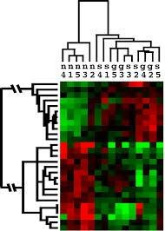
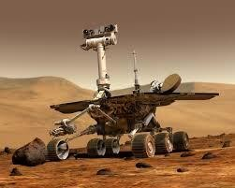
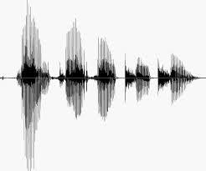
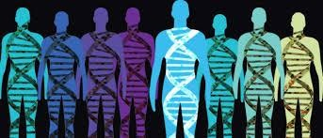
ML is used when:
• Human expertise does not exist (navigating on Mars)
• Humans can’t explain their expertise (speech recognition)
• Models must be customized (personalized medicine(
• Models are based on huge amounts of data (genomics)

Slide 18






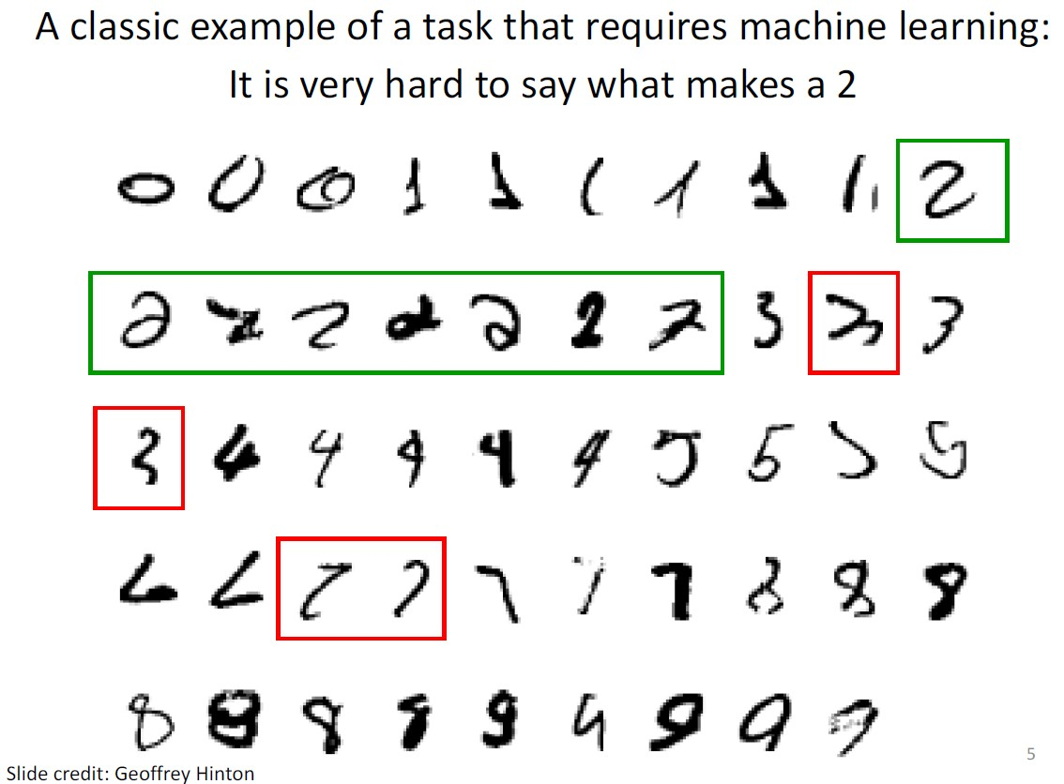

Slide 19
Some more examples of tasks that are best solved by using a learning algorithm
Recognizing patterns:
Facial identities or facial expressions
Handwritten or spoken words
Medical images
Generating patterns:
– Generating images or motion sequences
Recognizing anomalies:
Unusual credit card transactions
Unusual patterns of sensor readings in a nuclear power plant
Prediction:
– Future stock prices or currency exchange rates
Slide credit: Geoffrey Hinton

Slide 20
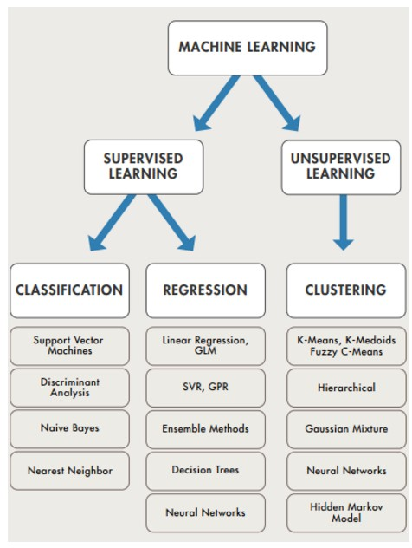

Slide 21
Supervised Learning
In supervised learning, we are given a data set and already know what our correct output should look like, having the idea that there is a relationship between the input and the output.
Supervised learning problems are categorized into "regression" and "classification" problems.
In a regression problem, we are trying to predict results within a continuous output, meaning that we are trying to map input variables to some continuous function.
In a classification problem, we are instead trying to predict results in a discrete output. In other words, we are trying to map input variables into discrete categories.

Slide 22


Training
Learning entries
Text, Images
Omic data,
usually entries are encoded
as vector (x1,x2,…..,xn)
Feature vectors
Etc…
Human expert labels
each learning entries
Machine learning algorithm
Labels
Testing Text, Images Omic data, Etc…
Feature vector
Expected Label
Predictive Model

Slide 23
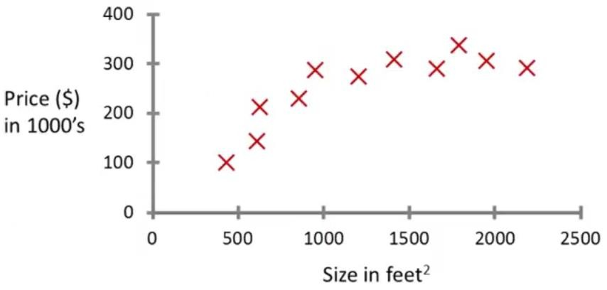
250
175
750
Supervised Learning
Regression:
“right answers” or “Labeled data” given
Predict continuous valued output (price)

Slide 24
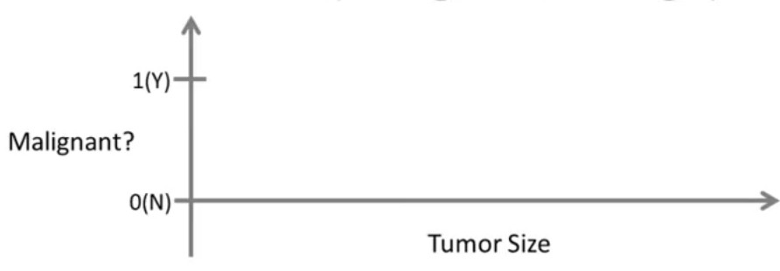













Lung Cancer
(Malignant or benging)
Classification
Discrete valued output (0 or 1)

Slide 25
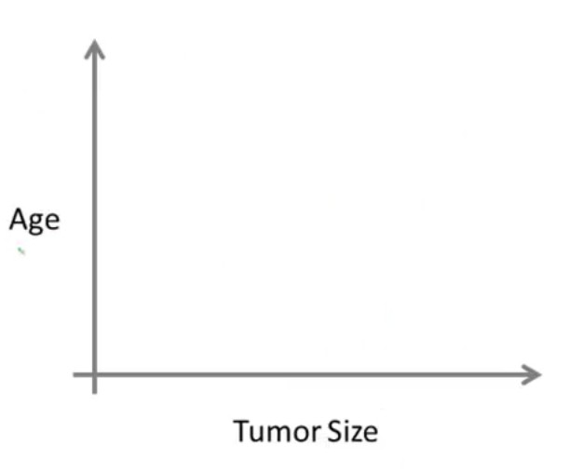







































Slide 26
Unsupervised Learning
Unsupervised learning, on the other hand, allows us to
approach problems with little or no idea what our results
should look like.
We can derive structure from data where we don't necessarily know the effect of the variables.
We can derive this structure by clustering the data based on
relationships among the variables in the data.
With unsupervised learning there is no feedback based on the prediction results, i.e., there is no teacher to correct you.

Slide 27

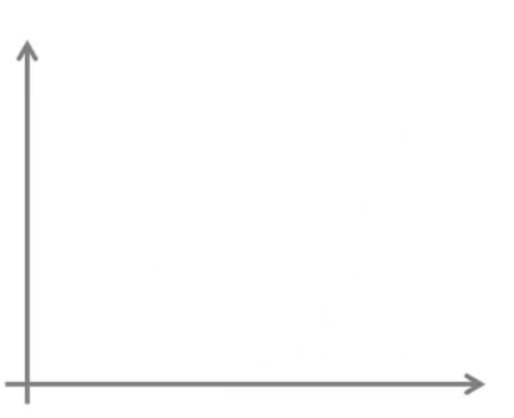











Y
X

Slide 28
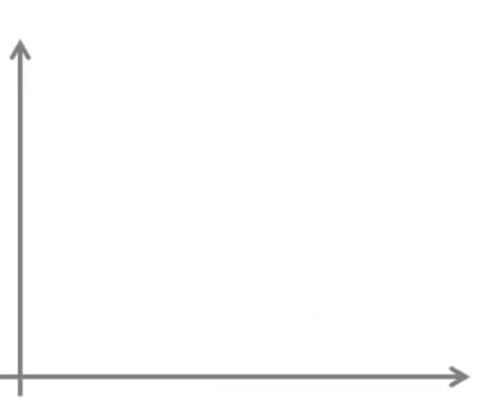


















Unsupervised
Y
X
Unsupervised learning is where you only have input data and no corresponding output variables.

Slide 29

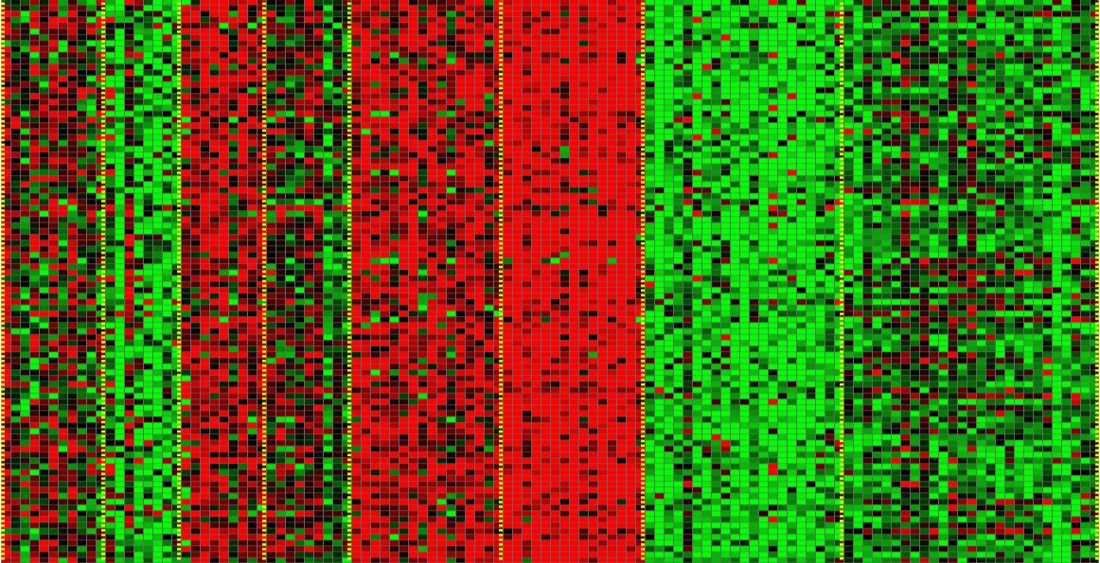
Unsupervised Learning applications
The expression of set of genes for a
certain individual
Genes
Individuals
We need to cluster the individuals based of the similarity of their genes.
[Source: Daphne Koller]

Slide 30
Unsupervised Learning applications
Genes
Individuals
Microarray data
Have a group of individuals
On each measure expression of a gene
Run algorithm to cluster individuals into types of people
[Source: Daphne Koller]

Slide 31



Slide 32
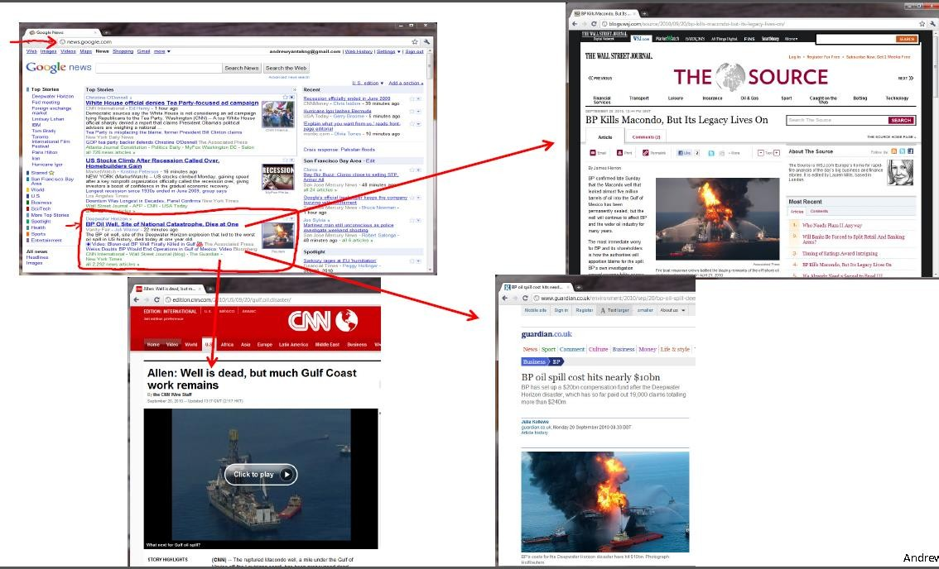

Slide 33
Learning Types
Supervised
Unsupervised
Discrete
Classification | Clustering
Regression | Dimensionality reduction
Continuous

Slide 34
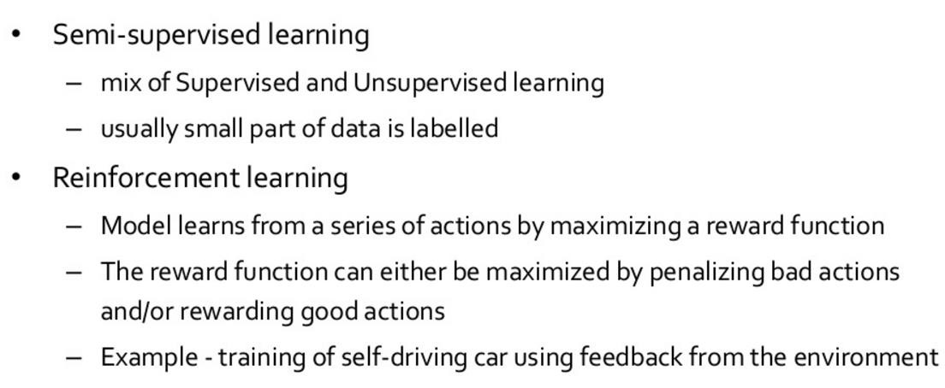
Machine Learning more types

